Slide 1

Mexico toys stores
ITI Graduation Project

Slide 2
Toys is a bigger business than you might think..
Sales & inventory data for a fictitious chain of toy stores in Mexico called Maven Toys, including information about products, stores, daily sales transactions, and current inventory levels at each location.

Slide 3




About The Dataset
Stores table contains the 50 Maven Toys store locations (each record represents one store), with fields containing details about the store location, type, and date it opened
Products table contains the 35 products sold at Maven Toys (each record represents one product), with fields containing details about the product category, cost, and retail price
Inventory table contains over 1,500 records that represent the stock on hand of each product in each store at the current point in time (Oct 1, 2018)
Sales table contains the units sold in over 800,000 sales transactions from January 2017 to October 2018 (each record represents the purchase of a specific product at a specific store on a specific date)

Slide 4
Why do we need analysis?
Expanding business
Profitable Products
Looking for undiscovered growing opportunities
What to sell more? What to sell less?
Heat map
Stores
What areas have more spending on toys?
Biggest Branches with most sales numbers
Costs
Inventory Centralization
Reducing unnecessary costs while maintaining sales
How to cover many stores using least number of inventory

Slide 5
ETL
SSIS
SSAS
01
02
Cubes with all possible data combination required for analysis
Extract and Transform data from CSVs to a data warehouse
Full insights
SSRS
04
03
Simple Reports with indicators of business performance
Loading data into visualization tools

Slide 6
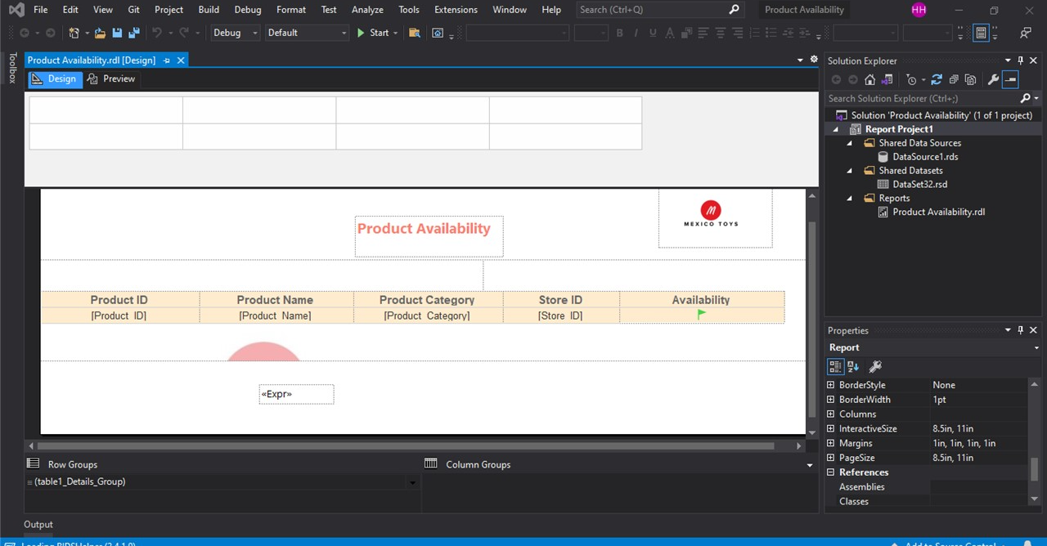
SSRS
1

Slide 7
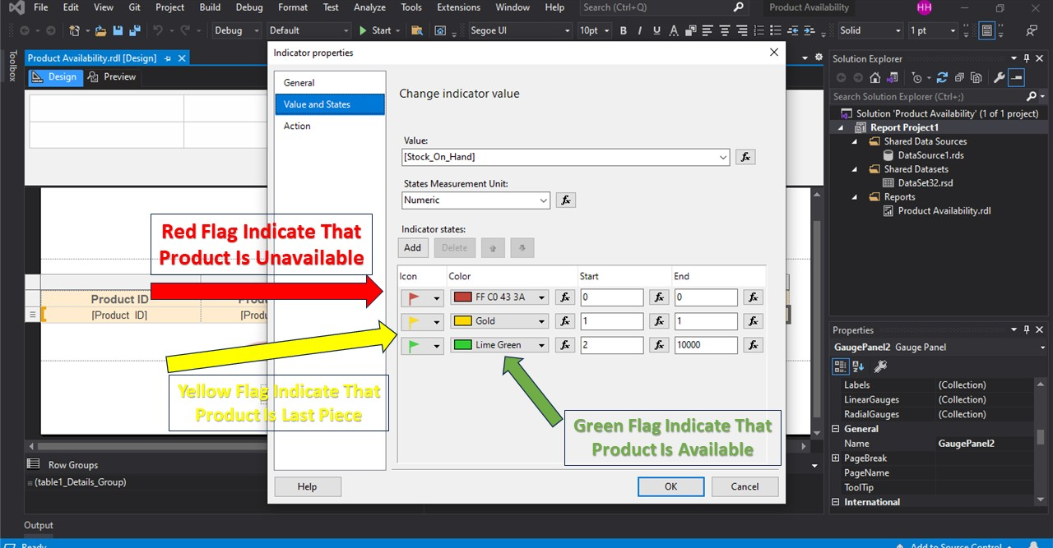
SSRS
2

Slide 8


Data Visualisation
Tableau
PowerBI
Business focused true to life visuals
More live visuals with beautiful eye comforting
45%
90%
65%
70%
25%
40%

Slide 9
Data sources
Mexico Toy Sales

Slide 10
Team Project :
Hesham Mohamed Hosny
Shrouk Osama Mohammed
Shaimaa Shawky Al-Nady
Mariam Moheb Fahmy
Osama Ayman Mostafa

Slide 11
Thanks

